Slide 1
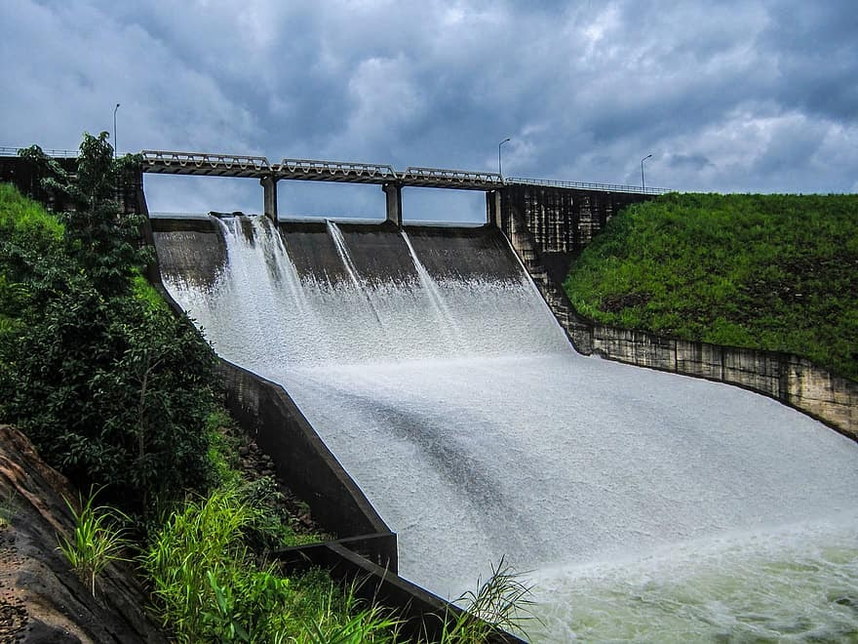
Producing Electricity using Hydropower

Slide 2
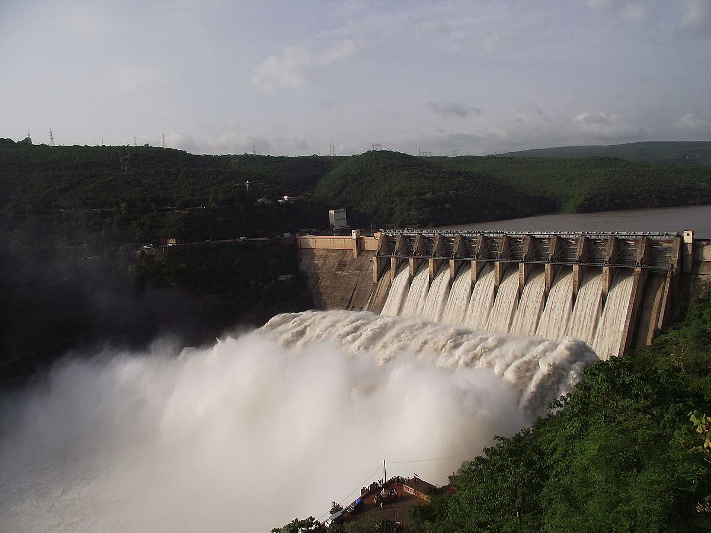
Where are hydroelectric power plants located?
How do they work?
This Photo by Unknown Author is licensed under CC BY-SA

Slide 3
1. Water from a stream or river is held up (blocked) by the sluice gate. Holding up more water increases potential energy and gravitational energy.

Slide 4
2. The gates are then opened. Water rushes down through the gate and into the tubes. There is immense kinetic energy in the very fast flowing water because of the high pressure it has.

Slide 5
3. Kinetic energy in the fast flowing water turns shafts (blades) connected to the end of the tubes. More fast flowing water means more blades can be turned even faster.

Slide 6
4. The spinning blades or shafts are connected to a generator which generates electricity. The generator is connected to a transformer which changes the electricity to the proper voltage so that it can be sent to our homes, businesses and other electricity customers.

Slide 7
Have you stood underneath a waterfall? What did it feel like?

Slide 8
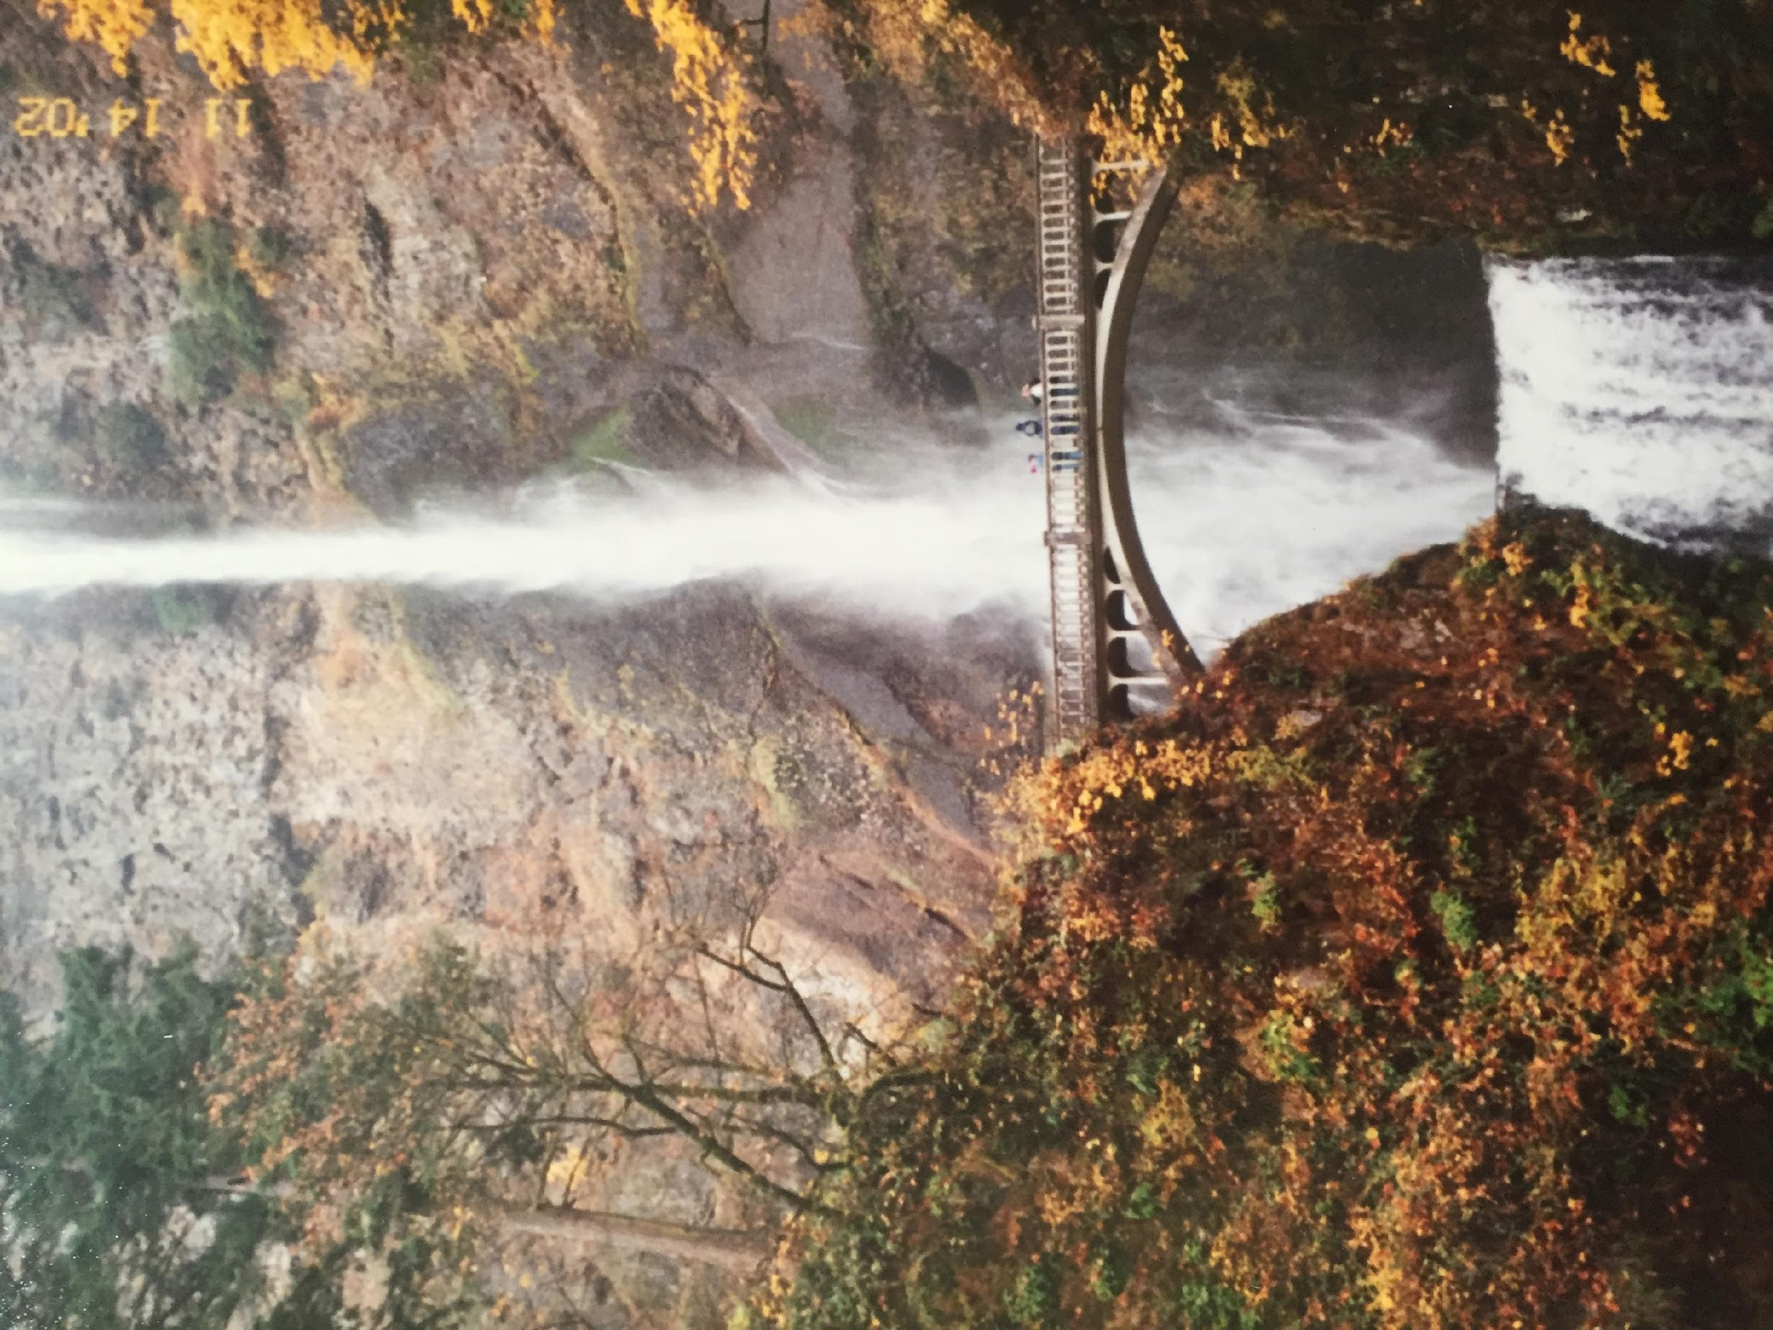
Which waterfall would have more power?

Slide 9
We can say that the water about to fall from a tall waterfall has more potential energy than the water at the top of a shorter waterfall.

Slide 10
When the water falls, or moves through the air, the potential energy decreases as the water gets closer to the ground. The moving water has kinetic energy, or the energy of movement. As the water falls through the air, its kinetic energy increases as its potential energy decreases. So when it finally strikes you at the bottom, all of its potential energy has been turned into kinetic energy.

Slide 11
This is in accordance with the idea that energy is never created or destroyed, it just changes form. That's the scientific and engineering way to understand why a waterfall has so much power.

Slide 12
Identify where the potential and kinetic energy would be in the picture below.

Slide 13
EXPLORATION:
In this activity we will build a model turbine connected to a generator to produce electricity.
We will demonstrate the relationship between the amount of kinetic energy in falling water and the amount of electrical energy produced by having the water fall from various heights.
The amount of electrical energy will be determined by using a multimeter to measure the voltage produced by the model turbine in units of volts.

Slide 14
Materials:
Black Hub from the Kid Wind wind kit
Motor from the Kid Wind solar Kit
6 Mini wooden spoons for paddles
2 alligator clips
Multimeter from the Kid Wind wind kit
Tape Measure
Water source - 2L pop bottle with water inside.
Tub to catch water

Slide 15
Procedure:
Connect the wooden spoons to the hub making sure all the paddles are facing the same direction.
Connect the hub to the motor.
Connect the alligator clips to the pins on the back of the motor.
Connect the other end of the alligator clips to the multimeter, and turn the multimeter to 20 DVC.
Look at the pictures on the next slide

Slide 16
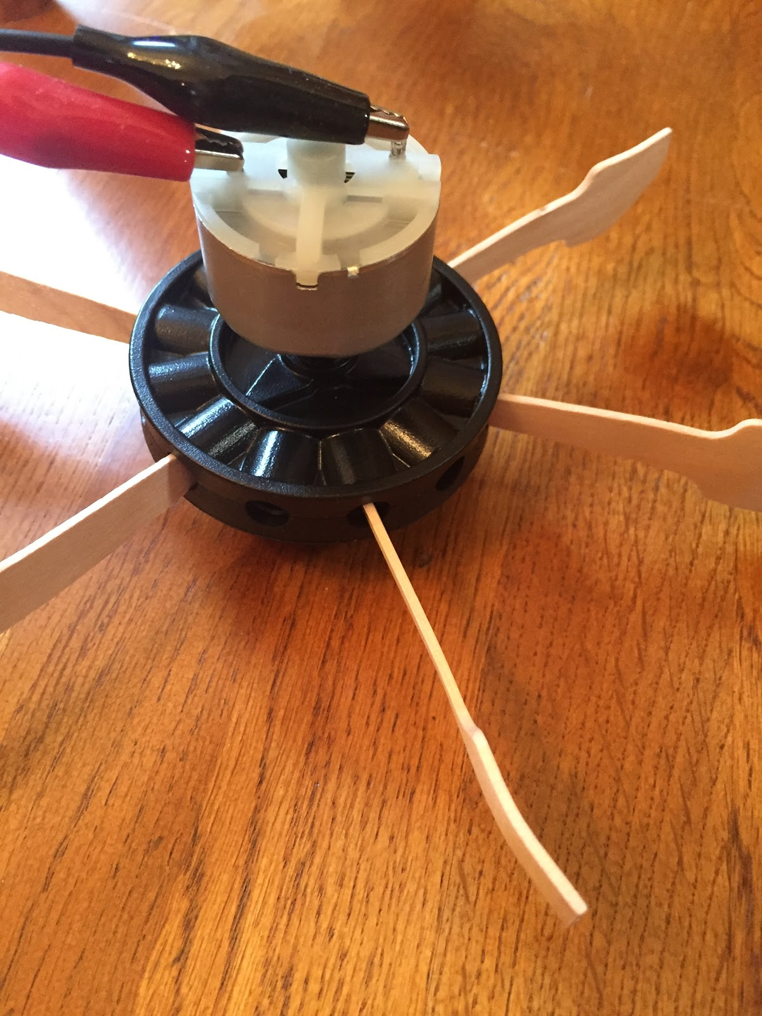
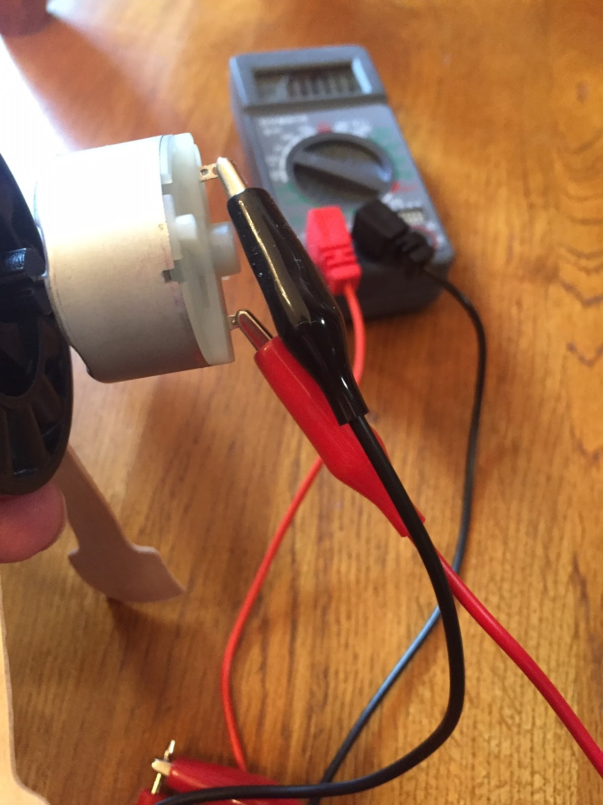

Slide 17
Working as a team, have one person hold the tape measure, one to read the multimeter, one to pour the water, and one to make sure the water is going in the tub. Someone also needs to be responsible for recording the results.
Pour the water over the paddles from a height of 1 meter, with the water falling in the tub. Record the voltage from the multimeter in the data table.
Pour the water over the paddles from a height of 50 cm. Record your results in the data table.
Pour the water over the paddles from a height of 25cm. Record your results in the data table.

Slide 18
Clean up and answer questions on student sheet.
EXPLANATION:
1.Did changing the height of where the water was poured from make a difference in the voltage?
2. Looking at the data table at what height was the most voltage produced?
3. Which height had the greatest potential energy?
4. Where is the kinetic energy?
5. Where in a dam would you find the turbine that the water goes through?
6. Does the height of a dam make a difference in the amount of electricity that is produced?
7. Where in the dam would the kinetic energy be the greatest?
8. What was your independent variable in this experiment?

